Slide 1
Efficient Algorithms
Ekkapot Charoenwanit
Electrical and Computer Engineering (ECE)
TGGS
KMUTNB

Slide 2
Lecture 15: Randomized Algorithms
Monte Carlo
Las Vegas

Slide 3
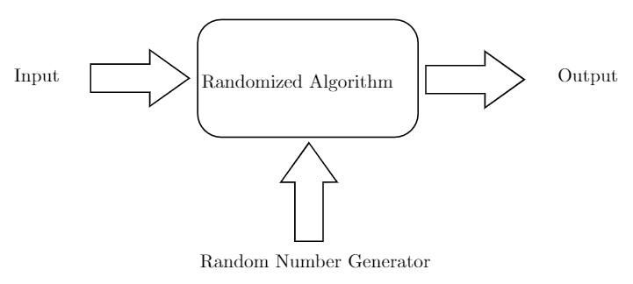
Randomized Algorithms
Randomized algorithms make use of randomness through a random number generator (RNG) in an attempt to improve the performance over worst-case performance of deterministic algorithms.

Slide 4
Randomized Algorithms
From the diagram, on two occasions where a randomized algorithm works on exactly the same input, the behavior of the algorithm may be inconsistent due to the randomness introduced by the random number generator.

Slide 5
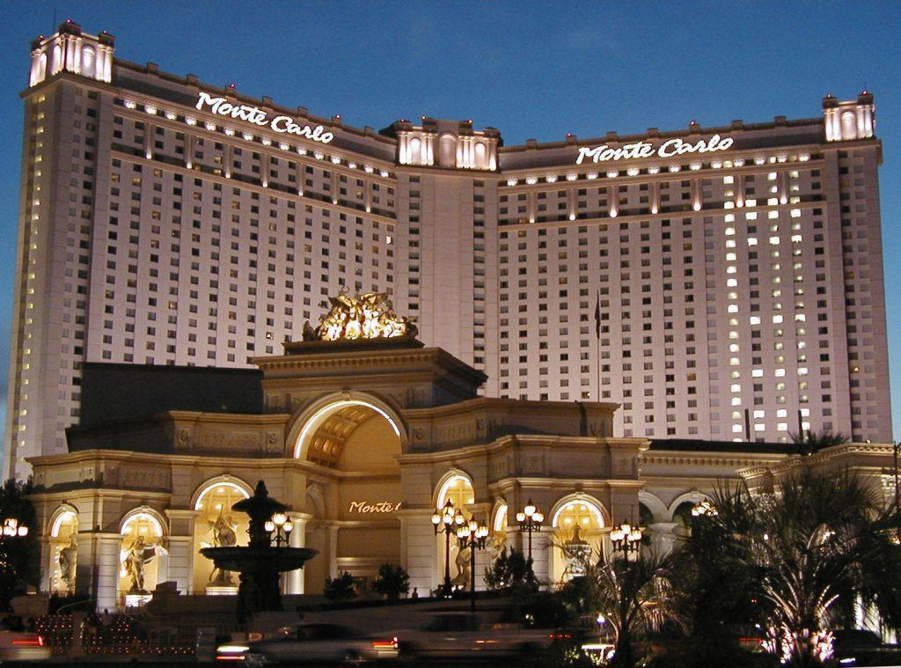

Monte Carlo and Las Vegas
A randomized algorithm is a
Monte Carlo randomized algorithm if
It returns a result which is probably correct
it always return a result
its running time is always deterministically bounded
Las Vegas randomized algorithm if
it always returns the correct result
Its running is bounded in expectation

Slide 6
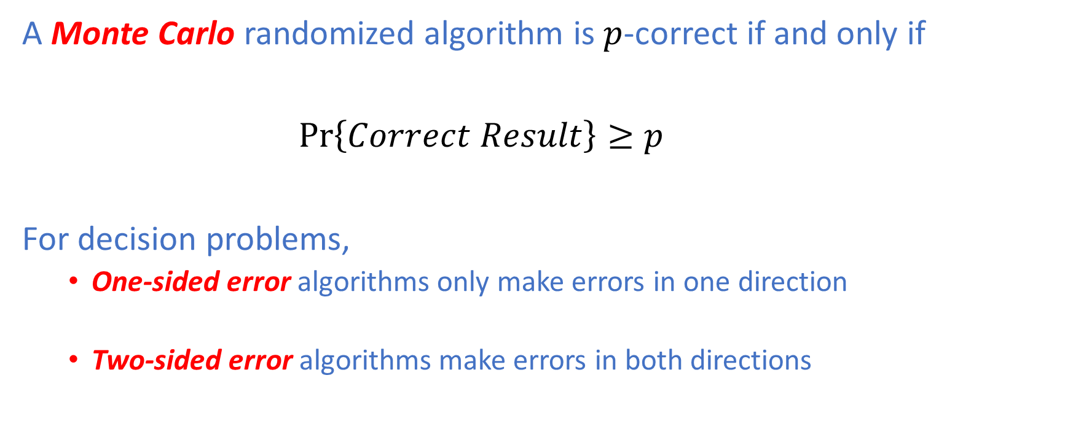
Monte Carlo
A Monte Carlo randomized algorithm is $p$-correct if and only if
$\operatorname{Pr}\left\{Correct Result\right\}≥p$
For decision problems,
One-sided error algorithms only make errors in one direction
Two-sided error algorithms make errors in both directions

Slide 7
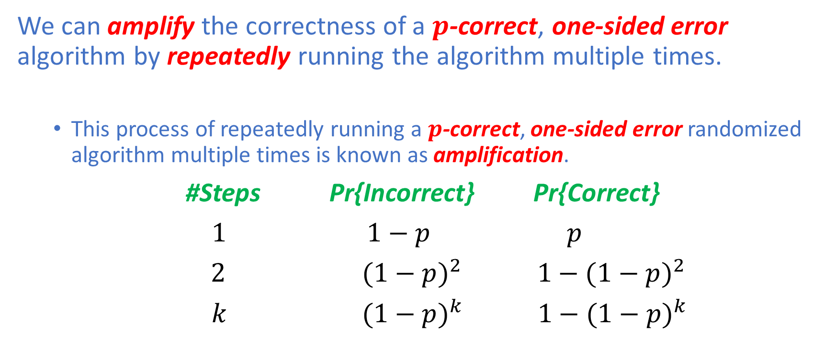
Monte Carlo
We can amplify the correctness of a $p$-correct, one-sided error algorithm by repeatedly running the algorithm multiple times.
This process of repeatedly running a $p$-correct, one-sided error randomized algorithm multiple times is known as amplification.
#Steps Pr{Incorrect} Pr{Correct}
$1$ $1−p$ $p$
$2$ ${(1−p)}^{2}$ ${ 1−(1−p)}^{2}$
$k$ ${(1−p)}^{k}$ ${ 1−(1−p)}^{k}$

Slide 8
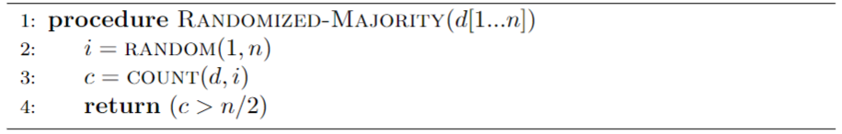
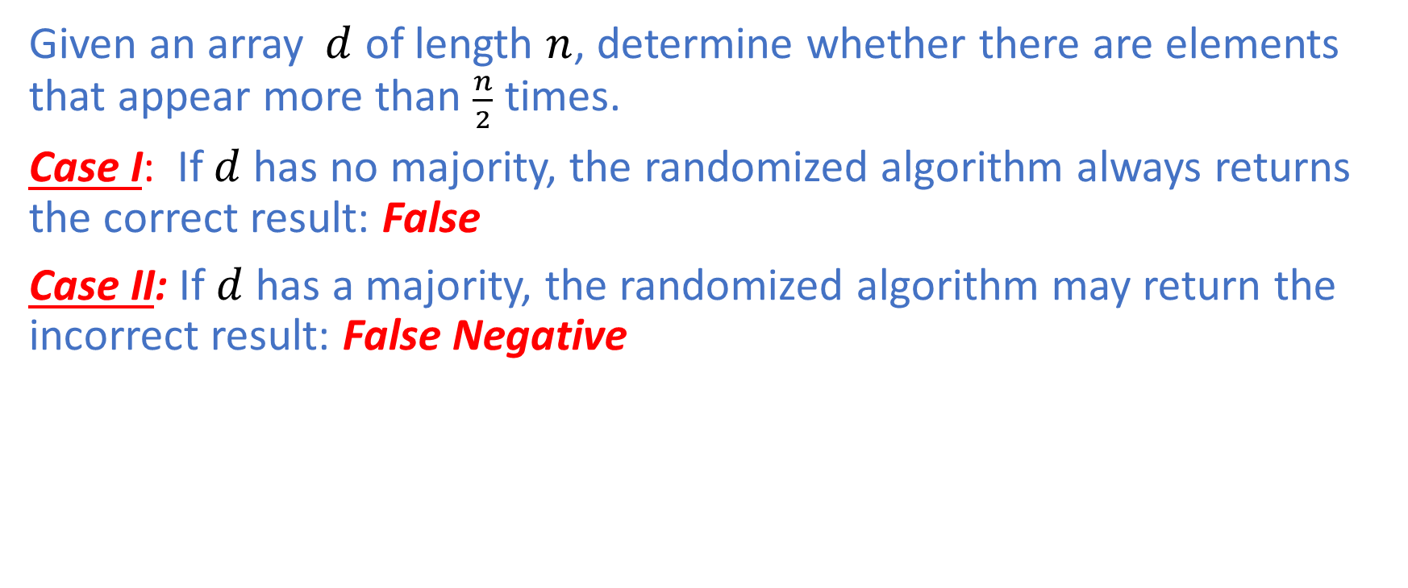
Majority
Given an array $d$ of length $n$, determine whether there are elements that appear more than $\frac{n}{2}$ times.
Case I: If $d$ has no majority, the randomized algorithm always returns the correct result: False
Case II: If $d$ has a majority, the randomized algorithm may return the incorrect result: False Negative

Slide 9
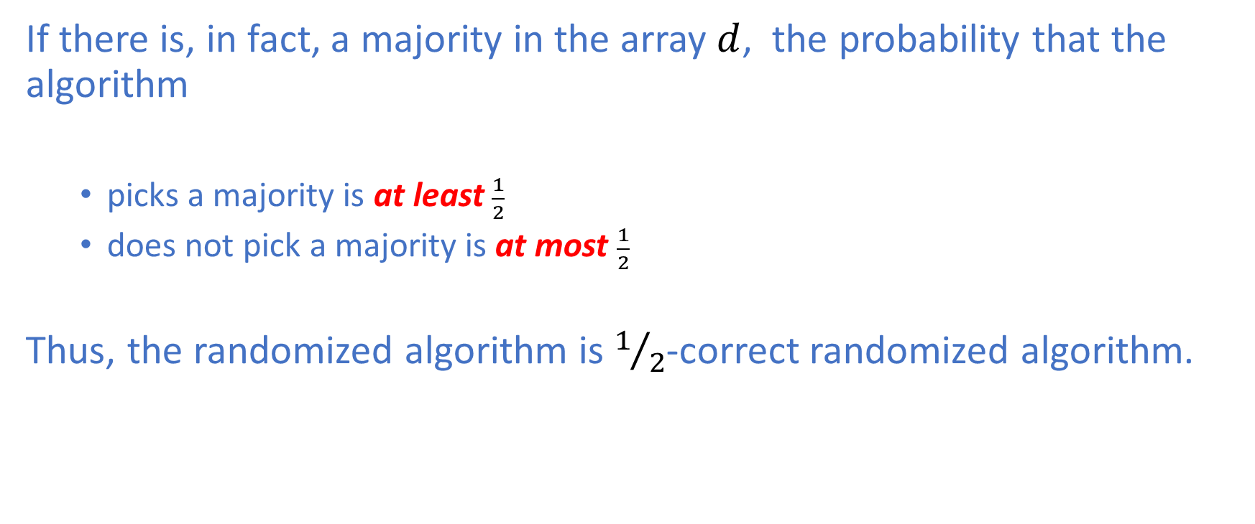
Majority: Analysis
If there is, in fact, a majority in the array $d$, the probability that the algorithm
picks a majority is at least $\frac{1}{2}$
does not pick a majority is at most $\frac{1}{2}$
Thus, the randomized algorithm is $1/2$-correct randomized algorithm.

Slide 10
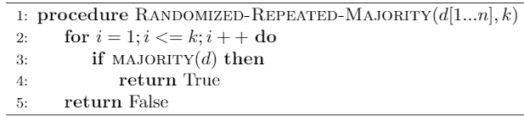
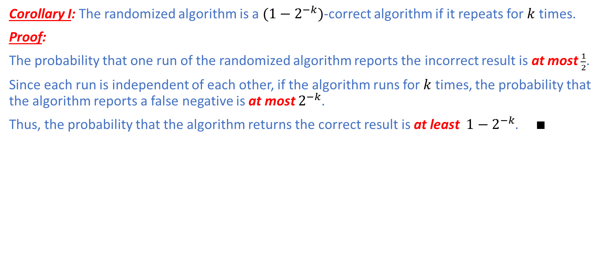
Majority: Analysis
Corollary I: The randomized algorithm is a $(1−2^{−k})$-correct algorithm if it repeats for $k$ times.
Proof:
The probability that one run of the randomized algorithm reports the incorrect result is at most $\frac{1}{2}$.
Since each run is independent of each other, if the algorithm runs for $k$ times, the probability that the algorithm reports a false negative is at most $2^{−k}$.
Thus, the probability that the algorithm returns the correct result is at least ${1−2}^{−k}$. $∎$

Slide 11
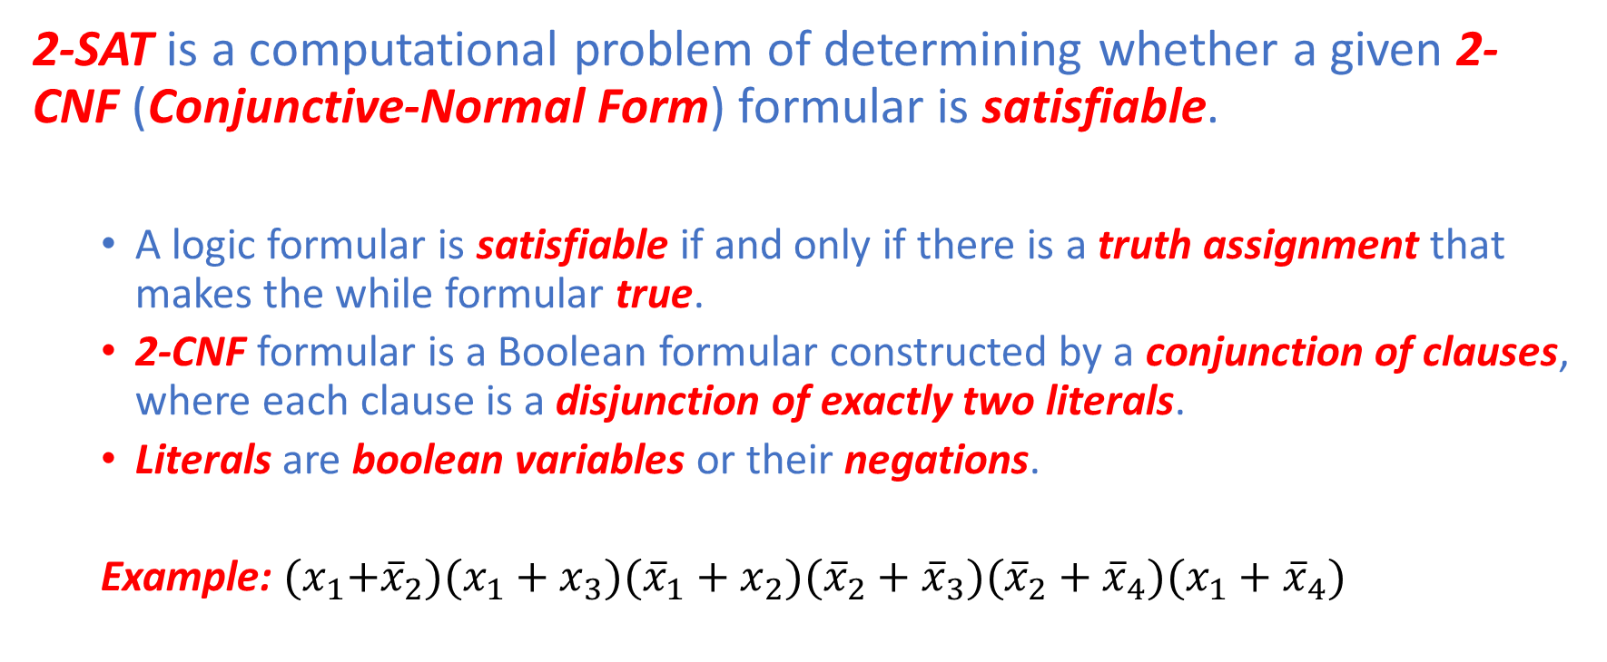
2-SAT
2-SAT is a computational problem of determining whether a given 2-CNF (Conjunctive-Normal Form) formular is satisfiable.
A logic formular is satisfiable if and only if there is a truth assignment that makes the while formular true.
2-CNF formular is a Boolean formular constructed by a conjunction of clauses, where each clause is a disjunction of exactly two literals.
Literals are boolean variables or their negations.
Example: ${(x}_{1}+{\overline{x}}_{2})(x_{1}+x_{3})({\overline{x}}_{1}+x_{2})({\overline{x}}_{2}+{\overline{x}}_{3})({\overline{x}}_{2}+{\overline{x}}_{4})({x_{1}+\overline{x}}_{4})$

Slide 12
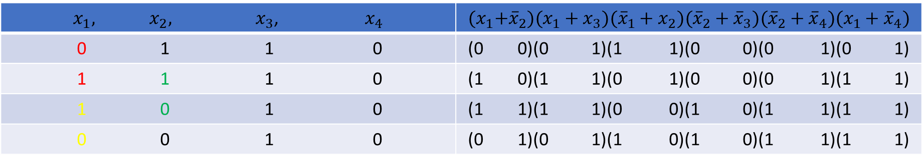
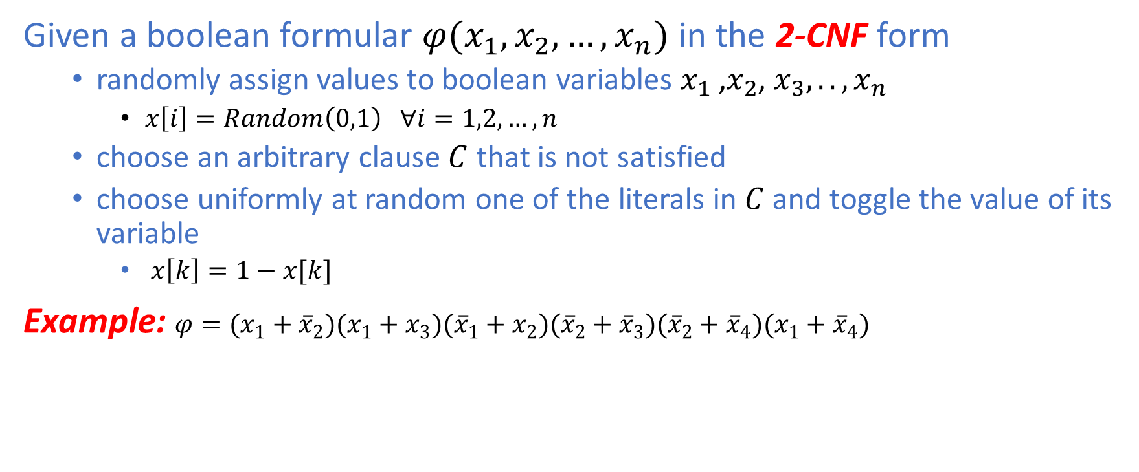
2-SAT
Given a boolean formular $φ(x_{1},x_{2},…,x_{n})$ in the 2-CNF form
randomly assign values to boolean variables $x_{1}$ ,$x_{2}$, $x_{3},..,x_{n}$
$x\left[i\right]=Random\left(0,1\right) ∀i=1,2,…,n$
choose an arbitrary clause $C$ that is not satisfied
choose uniformly at random one of the literals in $C$ and toggle the value of its variable
$x\left[k\right]=1−x[k]$
Example: ${φ=(x}_{1}+{\overline{x}}_{2})(x_{1}+x_{3})({\overline{x}}_{1}+x_{2})({\overline{x}}_{2}+{\overline{x}}_{3})({\overline{x}}_{2}+{\overline{x}}_{4})({x_{1}+\overline{x}}_{4})$
$x_{1},{ x}_{2},$ $x_{3}$, $x_{4}$ | $${(x}_{1}+{\overline{x}}_{2})(x_{1}+x_{3})({\overline{x}}_{1}+x_{2})({\overline{x}}_{2}+{\overline{x}}_{3})({\overline{x}}_{2}+{\overline{x}}_{4})({x_{1}+\overline{x}}_{4})$$
0 1 1 0 | (0 0)(0 1)(1 1)(0 0)(0 1)(0 1)
1 1 1 0 | (1 0)(1 1)(0 1)(0 0)(0 1)(1 1)
1 0 1 0 | (1 1)(1 1)(0 0)(1 0)(1 1)(1 1)
0 0 1 0 | (0 1)(0 1)(1 0)(1 0)(1 1)(1 1)

Slide 13
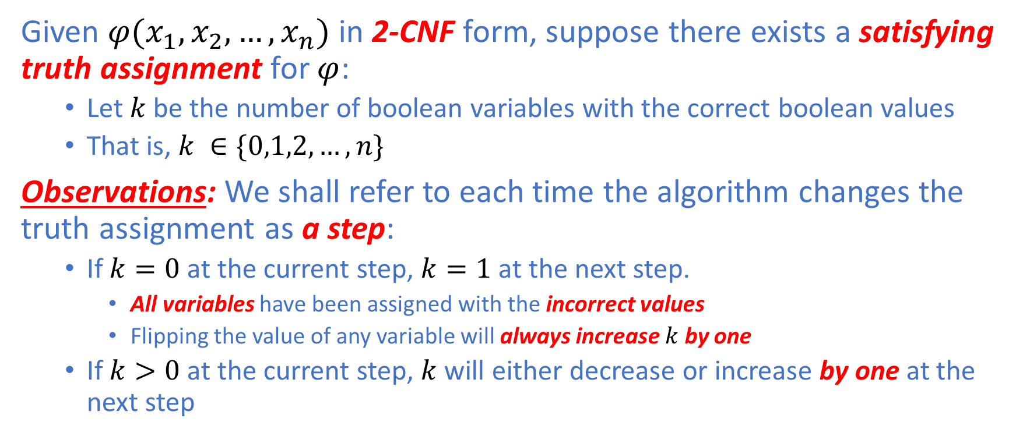
2-SAT: Analysis
Given $φ(x_{1},x_{2},…,x_{n})$ in 2-CNF form, suppose there exists a satisfying truth assignment for $φ$:
Let $k$ be the number of boolean variables with the correct boolean values
That is, $k ∈\{0,1,2,…,n\}$
Observations: We shall refer to each time the algorithm changes the truth assignment as a step:
If $k=0$ at the current step, $k=1$ at the next step.
All variables have been assigned with the incorrect values
Flipping the value of any variable will always increase $k$ by one
If $k>0$ at the current step, $k$ will either decrease or increase by one at the next step

Slide 14
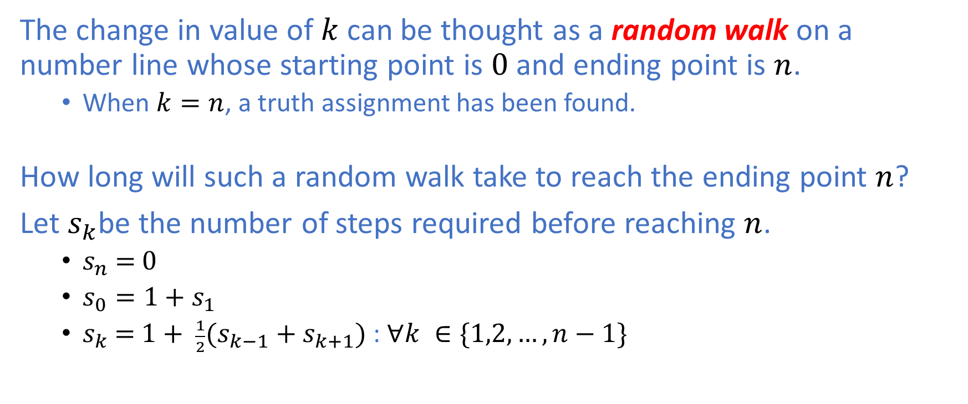
2-SAT: Analysis
The change in value of $k$ can be thought as a random walk on a number line whose starting point is $0$ and ending point is $n$.
When $k=n$, a truth assignment has been found.
How long will such a random walk take to reach the ending point $n$?
Let $s_{k}$be the number of steps required before reaching $n$.
$s_{n}\text{ = }0$
$s_{0}=1+s_{1}$
$s_{k} \text{=} 1+ \frac{1}{2}(s_{k−1}+s_{k+1})$ : $∀k ∈\{1,2,…,n−1\}$

Slide 15
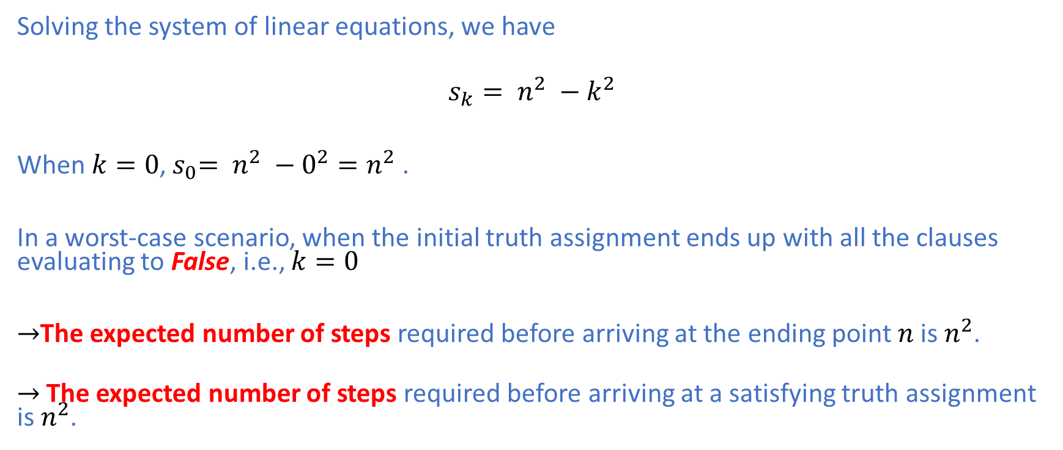
2-SAT: Analysis
Solving the system of linear equations, we have
$$s_{k}= n^{2} −k^{2}$$
When $k=0$,${ s}_{0}= n^{2} −0^{2}=n^{2}$.
In a worst-case scenario, when the initial truth assignment ends up with all the clauses evaluating to False, i.e., $k=0$
$→$The expected number of steps required before arriving at the ending point $n$ is $n^{2}$.
$→$The expected number of steps required before arriving at a satisfying truth assignment is $n^{2}$.

Slide 16
2-SAT: Analysis
Case I: If the algorithm returns True, there certainly exists a satisfying truth assignment.
Case II: If the algorithm returns False, one of the following two possibilities holds:
There is no satisfying truth assignment for the given 2-CNF formular
There is a satisfying truth assignment but the algorithm gave up and terminated too early

Slide 17
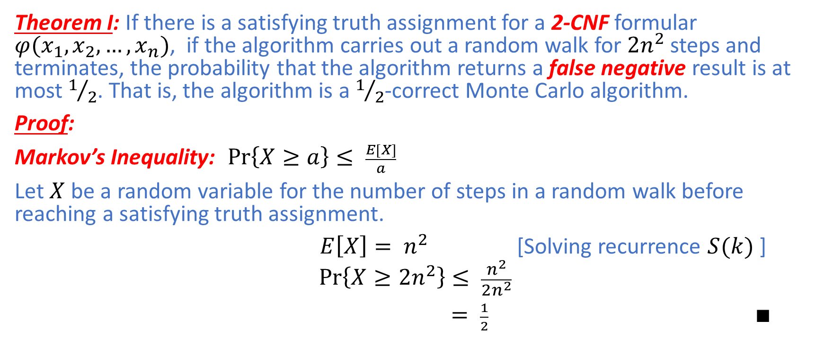
2-SAT: Analysis
Theorem I: If there is a satisfying truth assignment for a 2-CNF formular $φ(x_{1},x_{2},…,x_{n})$, if the algorithm carries out a random walk for $2n^{2}$ steps and terminates, the probability that the algorithm returns a false negative result is at most $1/2$. That is, the algorithm is a $1/2$-correct Monte Carlo algorithm.
Proof:
Markov’s Inequality: $\operatorname{Pr}\left\{X≥a\right\}≤ \frac{E[X]}{a}$
Let $X$ be a random variable for the number of steps in a random walk before reaching a satisfying truth assignment.
$E\left[X\right]= n^{2}$ [Solving recurrence $S(k)$ ]
$$\operatorname{Pr}\left\{X≥2n^{2}\right\}≤ \frac{n^{2}}{2n^{2}}$$
$= \frac{1}{2}$ $∎$

Slide 18
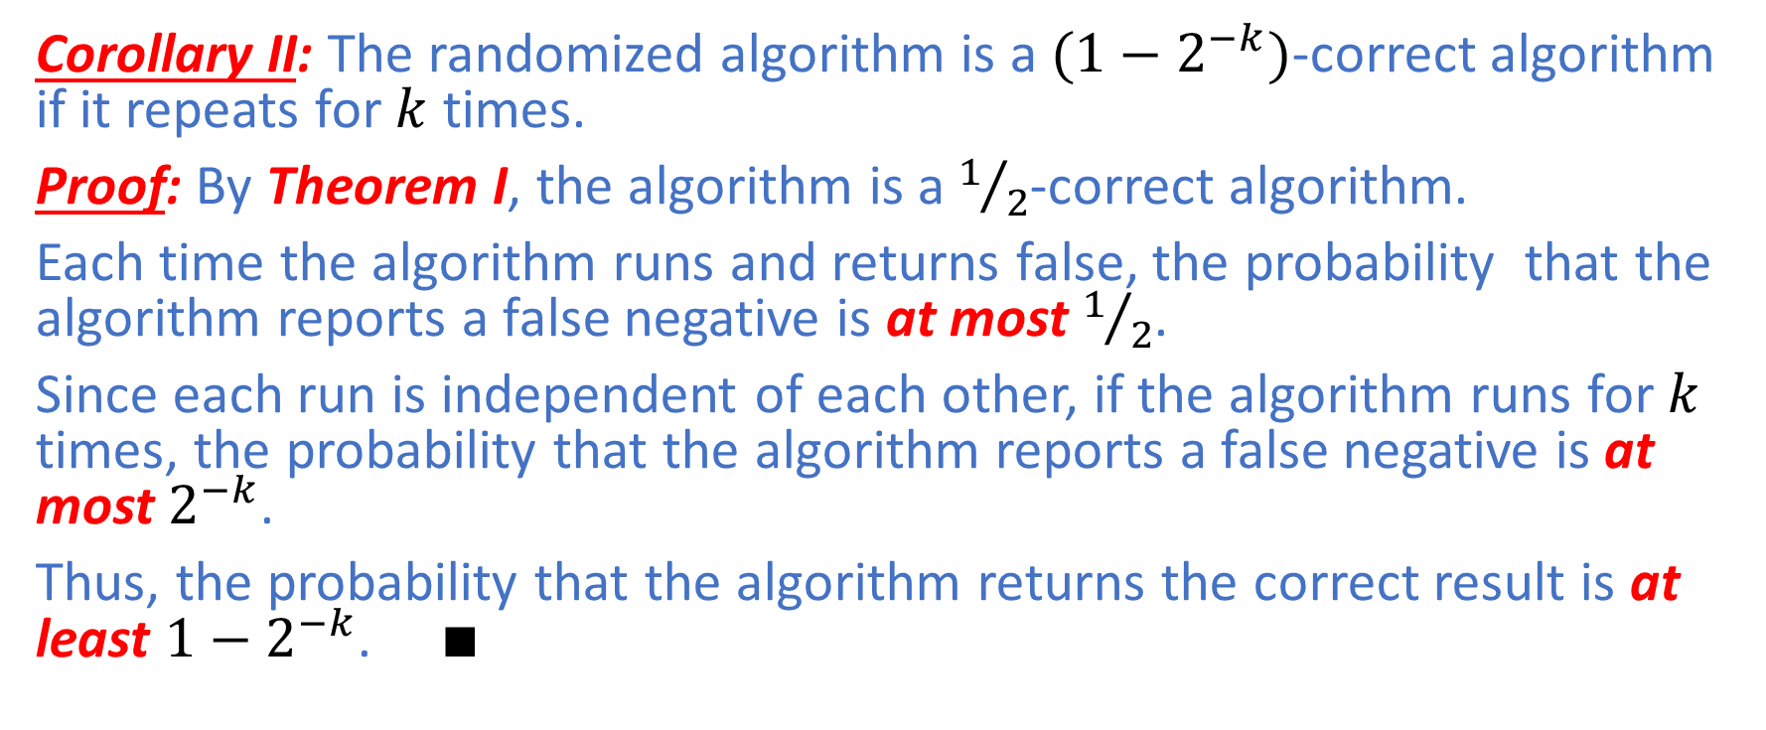
2-SAT: Analysis
Corollary II: The randomized algorithm is a $(1−2^{−k})$-correct algorithm if it repeats for $k$ times.
Proof: By Theorem I, the algorithm is a $1/2$-correct algorithm.
Each time the algorithm runs and returns false, the probability that the algorithm reports a false negative is at most $1/2$.
Since each run is independent of each other, if the algorithm runs for $k$ times, the probability that the algorithm reports a false negative is at most $2^{−k}$.
Thus, the probability that the algorithm returns the correct result is at least ${1−2}^{−k}$. $∎$

Slide 19
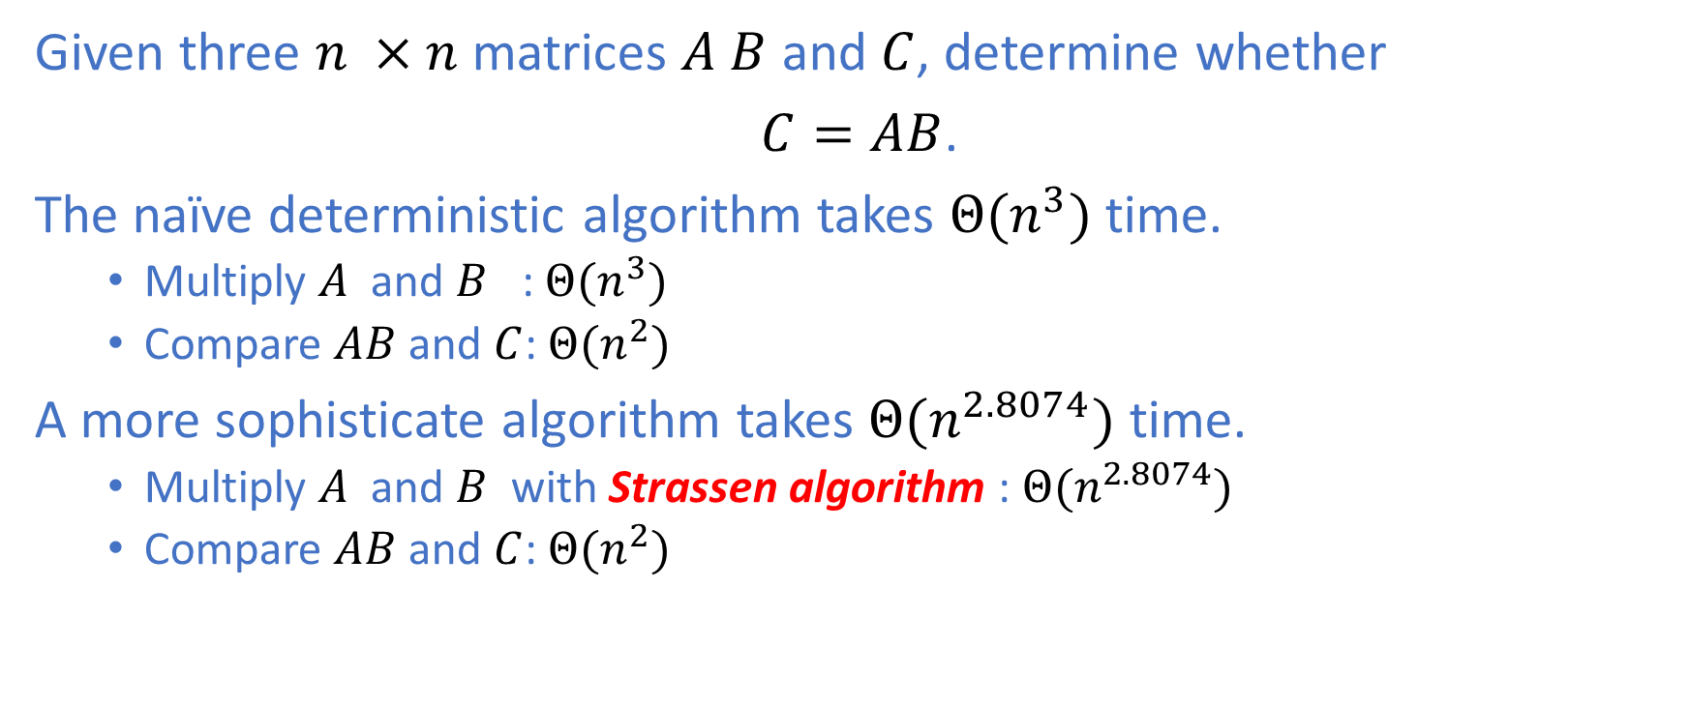
Freivalds' algorithm
Given three $n ×n$matrices $A B$ and $C$, determine whether
$C=AB$.
The naïve deterministic algorithm takes $Θ(n^{3})$ time.
Multiply $A$ and $B$ : $Θ(n^{3})$
Compare $AB$ and $C$: $Θ(n^{2})$
A more sophisticate algorithm takes $Θ(n^{2.8074})$ time.
Multiply $A$ and $B$ with Strassen algorithm : $Θ(n^{2.8074})$
Compare $AB$ and $C$: $Θ(n^{2})$

Slide 20
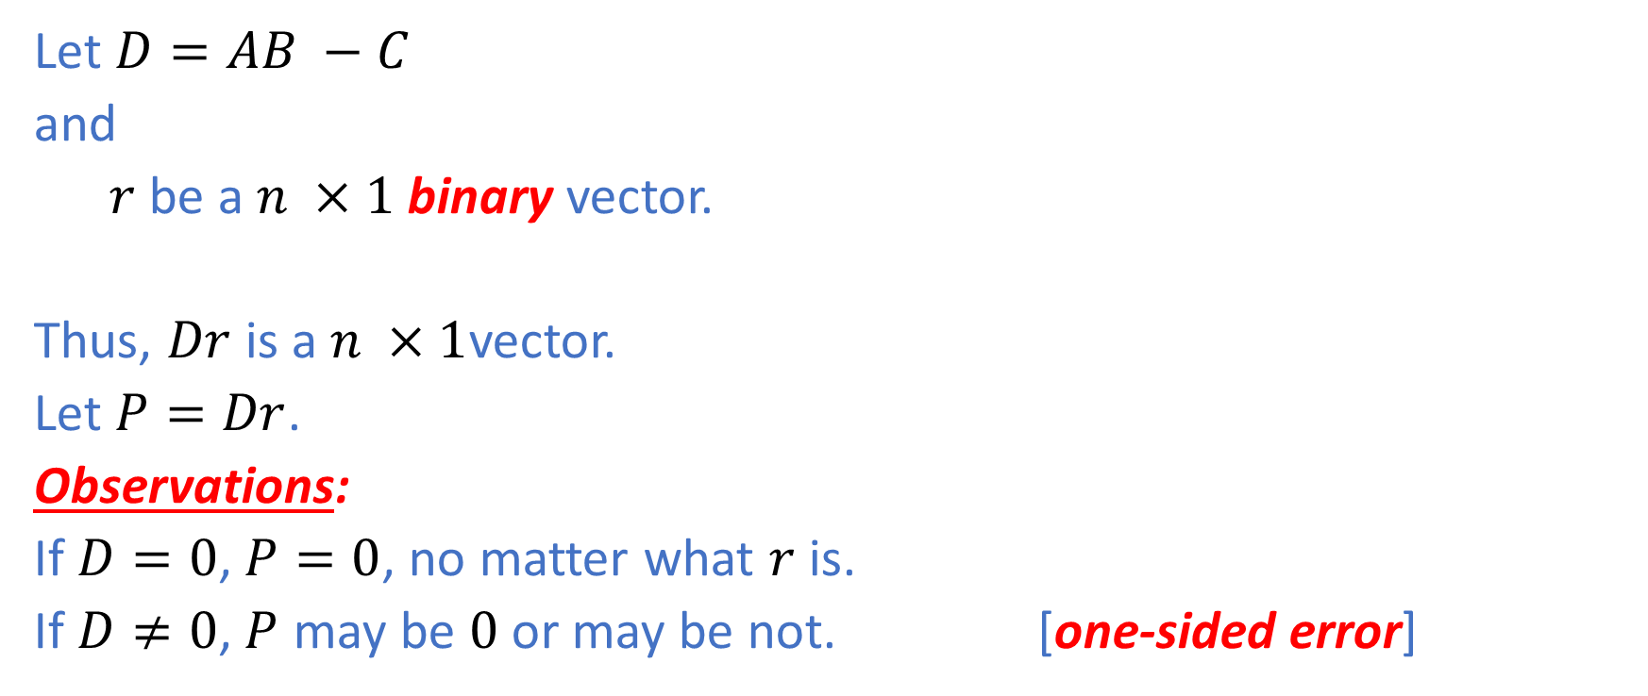
Freivalds' algorithm: Analysis
Let $D=AB −C$
and
$r$ be a $n ×1$binary vector.
Thus, $Dr$ is a$n ×1$vector.
Let $P=Dr$.
Observations:
If $D=0$, $P=0$, no matter what $r$ is.
If $D≠0$, $P$ may be $0$ or may be not. [one-sided error]

Slide 21
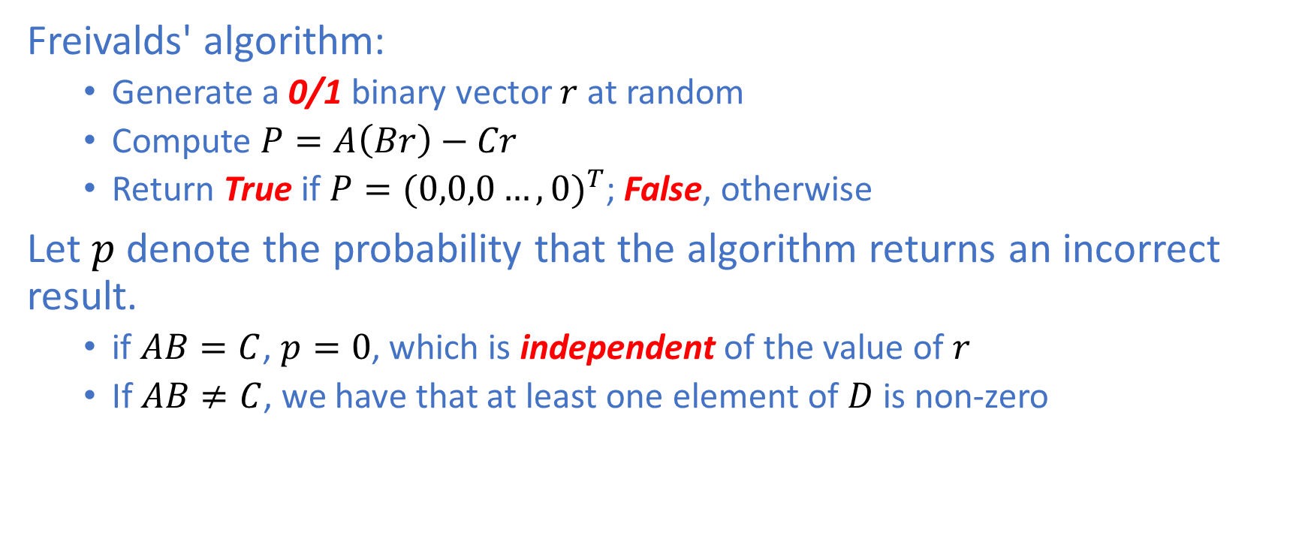
Freivalds' algorithm: Analysis
Freivalds' algorithm:
Generate a 0/1 binary vector $r$at random
Compute $P=A\left(Br\right)−Cr$
Return True if $P={(0,0,0…,0)}^{T}$; False, otherwise
Let $p$ denote the probability that the algorithm returns an incorrect result.
if $AB=C$, $p=0$, which is independent of the value of $r$
If $AB≠C$, we have that at least one element of $D$ is non-zero

Slide 22
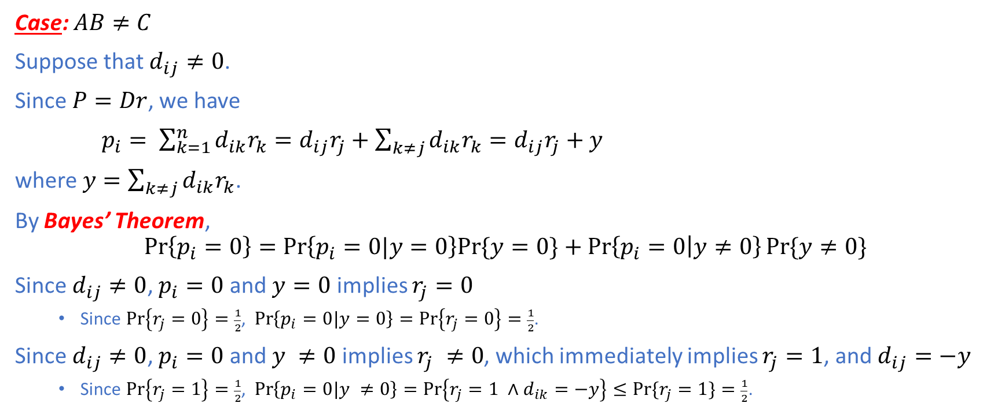
Freivalds' algorithm: Analysis
Case: $AB≠C$
Suppose that $d_{ij}≠0$.
Since $P=Dr$, we have
$p_{i}= \sum_{k=1}^{n}{d_{ik}r_{k}=d_{ij}r_{j}+\sum_{k≠j}{d_{ik}r_{k}=d_{ij}r_{j}+y}}$
where $y=\sum_{k≠j}{d_{ik}r_{k}}$.
By Bayes’ Theorem,
$$\operatorname{Pr}\left\{p_{i}=0\right\}=\operatorname{Pr}\left\{p_{i}=0|y=0\right\}Pr⁡\{y=0\}+\operatorname{Pr}\left\{p_{i}=0 | y≠0\right\}Pr⁡\{y≠0\}$$
Since $d_{ij}≠0$, $p_{i}=0$ and $y=0$ implies $r_{j}=0$
Since $\operatorname{Pr}\left\{r_{j}=0\right\}=\frac{1}{2}$, $\operatorname{Pr}\left\{p_{i}=0|y=0\right\}=\operatorname{Pr}\left\{r_{j}=0\right\}=\frac{1}{2}$.
Since $d_{ij}≠0$, $p_{i}=0$ and $y ≠0$ implies $r_{j} ≠0$, which immediately implies $r_{j}=1$, and $d_{ij}=−y$
Since $\operatorname{Pr}\left\{r_{j}=1\right\}=\frac{1}{2}$, $\operatorname{Pr}\left\{p_{i}=0|y ≠0\right\}=\operatorname{Pr}\left\{r_{j}=1 ∧d_{ik}=−y\right\}≤Pr⁡\{r_{j}=1\}=\frac{1}{2}$.

Slide 23
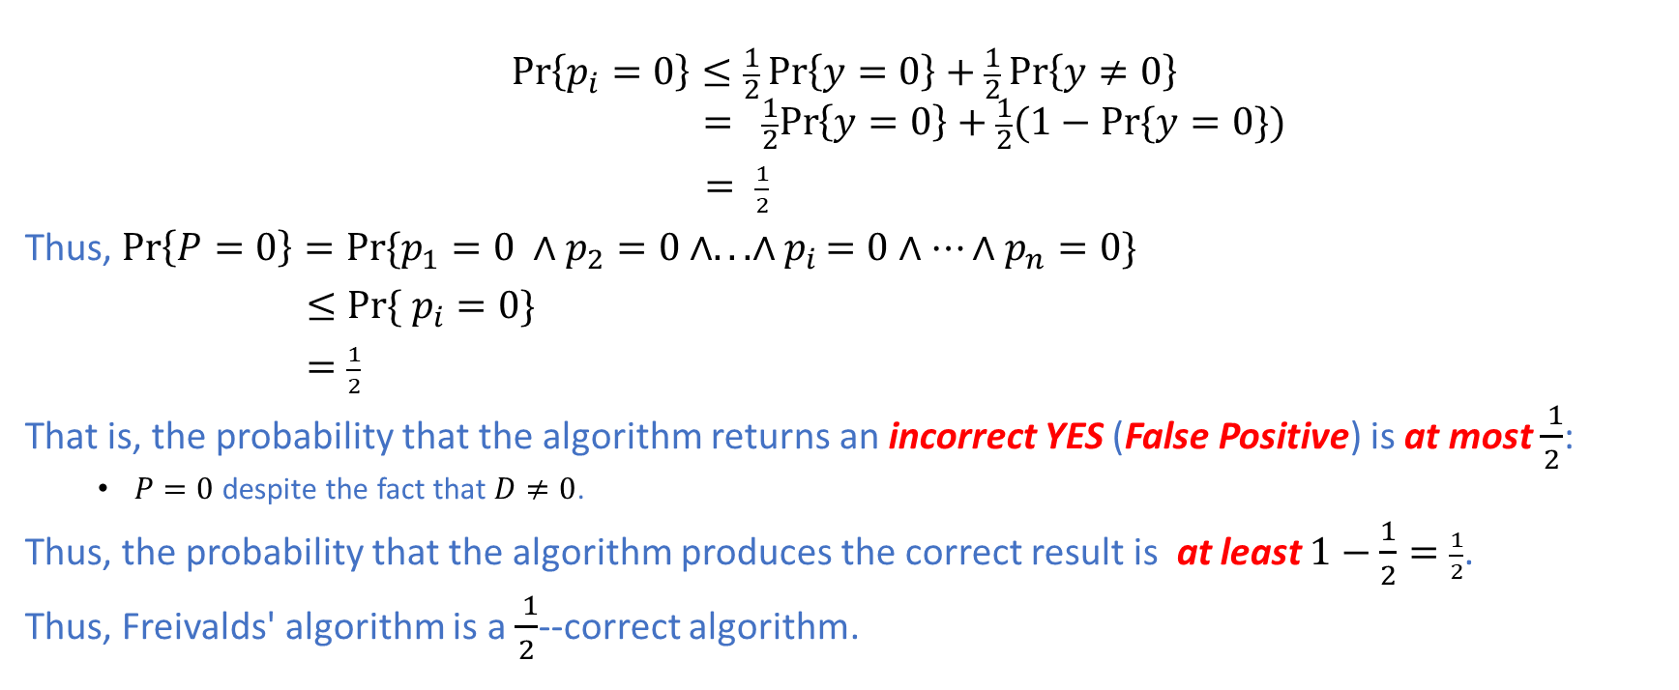
Freivalds' algorithm: Analysis
$$\operatorname{Pr}\left\{p_{i}=0\right\}≤\frac{1}{2}\operatorname{Pr}\left\{y=0\right\}+\frac{1}{2}\operatorname{Pr}\left\{y≠0\right\}$$
$$=\frac{1}{2}Pr\left\{y=0\right\}+\frac{1}{2}(1−Pr⁡\{y=0\})$$
$= \frac{1}{2}$
Thus, $\operatorname{Pr}\left\{P=0\right\}=Pr⁡\{p_{1}=0 ∧p_{2}=0∧..{.∧p}_{i}=0∧…∧p_{n}=0\}$
$≤Pr⁡\{ p_{i}=0\}$
$=\frac{1}{2}$
That is, the probability that the algorithm returns an incorrect YES (False Positive) is at most $\frac{ 1}{2}$:
$P=0$ despite the fact that $D≠0$.
Thus, the probability that the algorithm produces the correct result is at least $1−\frac{1}{2}=\frac{1}{2}$.
Thus, Freivalds' algorithm is a $\frac{ 1}{2}$--correct algorithm.

Slide 24
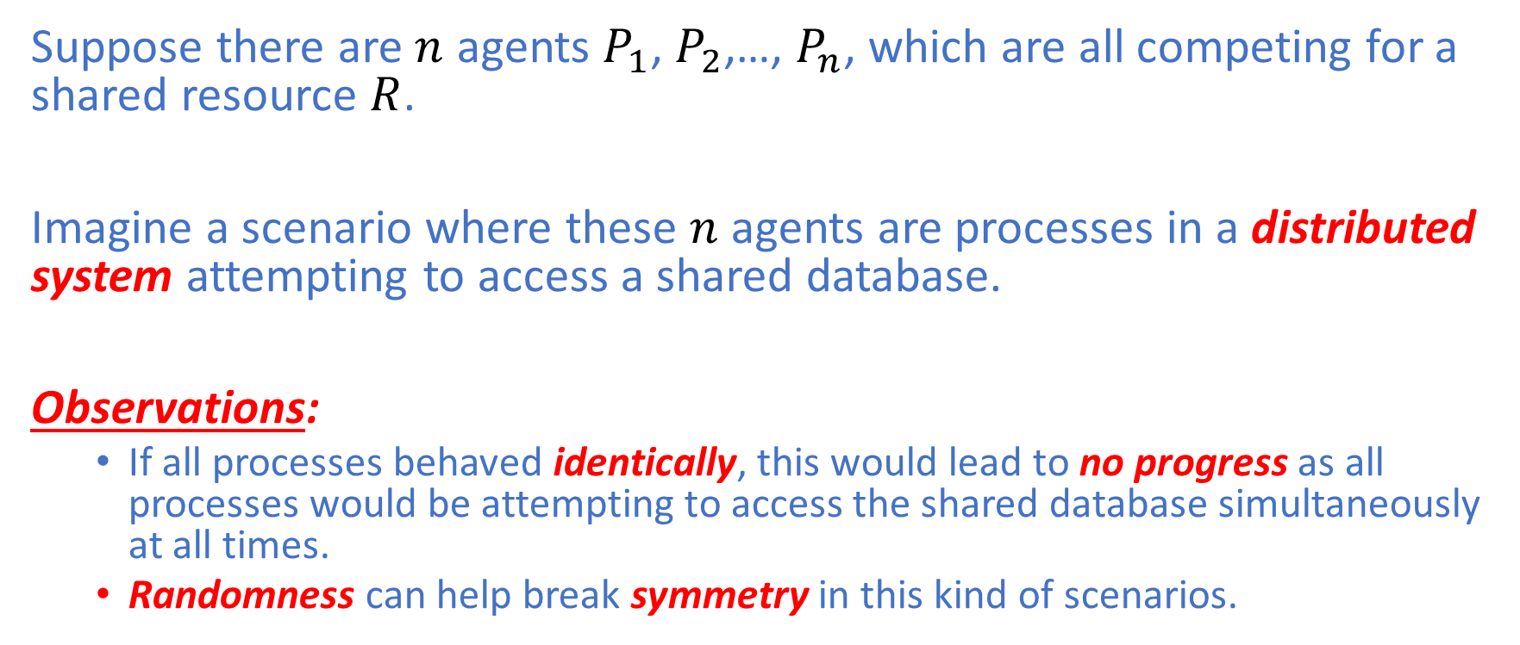
Contention Resolution
Suppose there are $n$ agents $P_{1}$, $P_{2}$,…, $P_{n}$, which are all competing for a shared resource $R$.
Imagine a scenario where these $n$ agents are processes in a distributed system attempting to access a shared database.
Observations:
If all processes behaved identically, this would lead to no progress as all processes would be attempting to access the shared database simultaneously at all times.
Randomness can help break symmetry in this kind of scenarios.

Slide 25
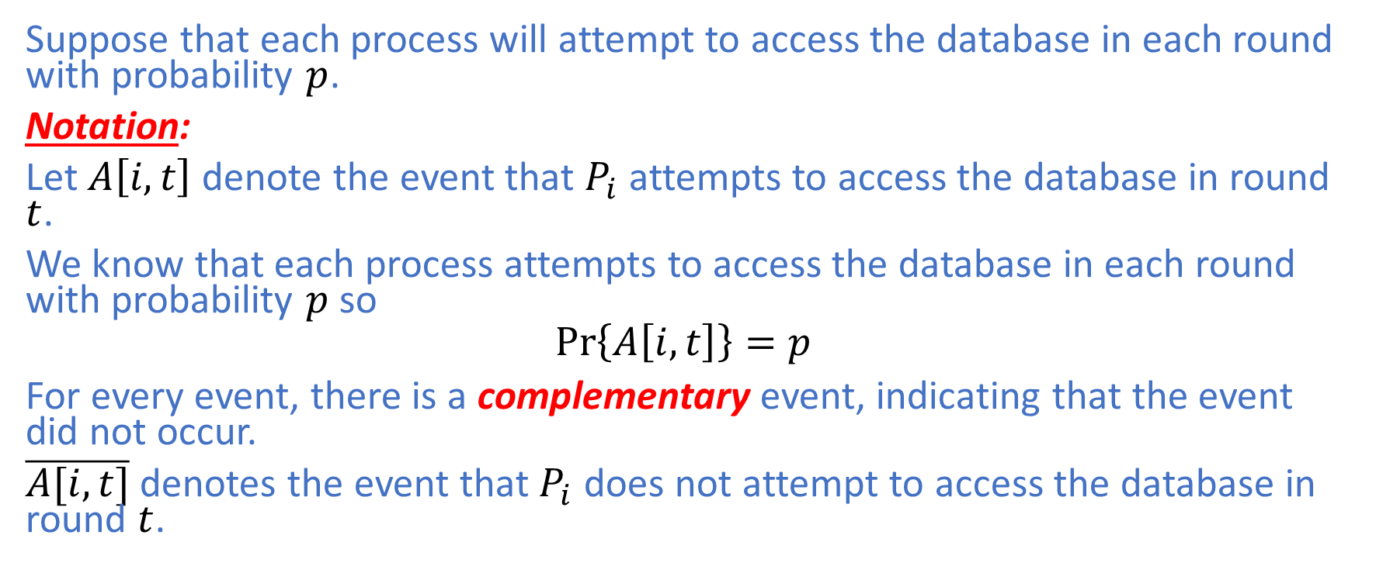
Contention Resolution: Analysis
Suppose that each process will attempt to access the database in each round with probability $p$.
Notation:
Let $A\left[i,t\right]$ denote the event that $P_{i}$ attempts to access the database in round $t$.
We know that each process attempts to access the database in each round with probability $p$ so
$$\operatorname{Pr}\left\{A\left[i,t\right]\right\}=p$$
For every event, there is a complementary event, indicating that the event did not occur.
$\overline{A[i,t]}$ denotes the event that $P_{i}$ does not attempt to access the database in round $t$.

Slide 26
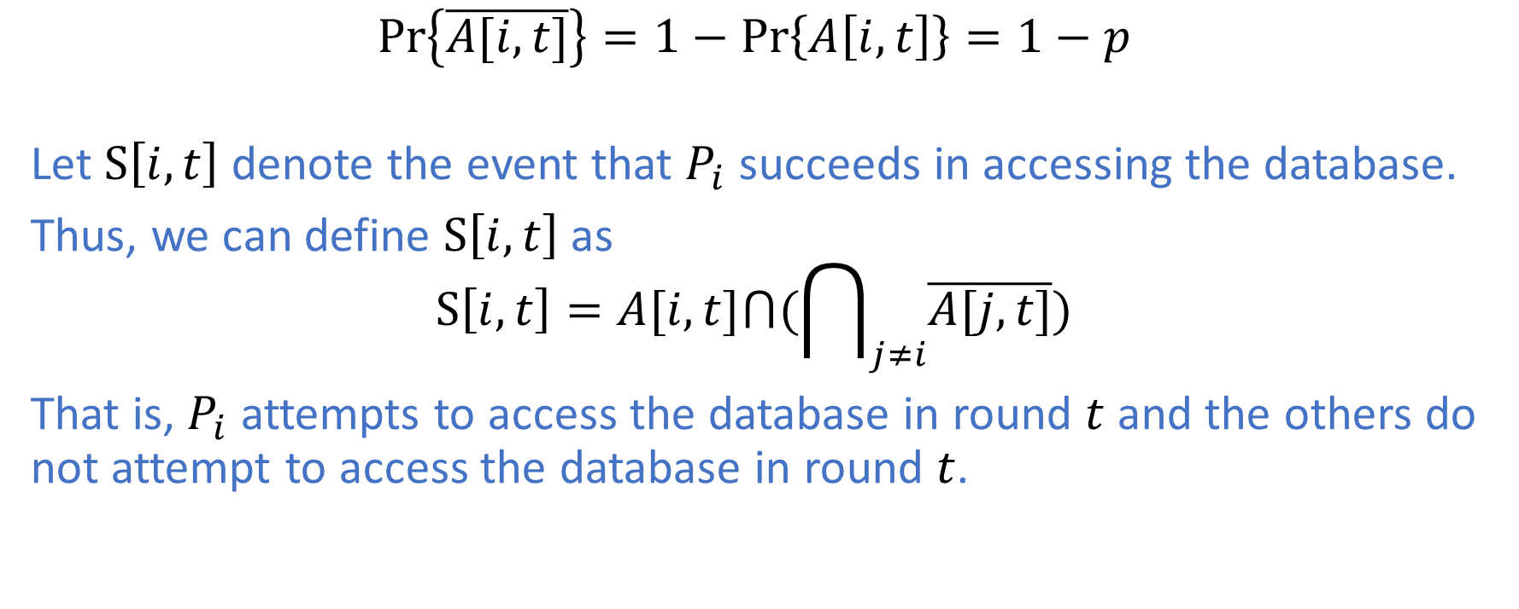
Contention Resolution: Analysis
$$\operatorname{Pr}\left\{\overline{A[i,t]}\right\}=1−Pr\left\{A\left[i,t\right]\right\}=1−p$$
Let $S\left[i,t\right]$ denote the event that $P_{i}$ succeeds in accessing the database.
Thus, we can define $S\left[i,t\right]$ as
$$S\left[i,t\right]=A[i,t]⋂(\bigcap_{j≠i}{\overline{A[j,t]}})$$
That is, $P_{i}$ attempts to access the database in round $t$ and the others do not attempt to access the database in round $t$.

Slide 27
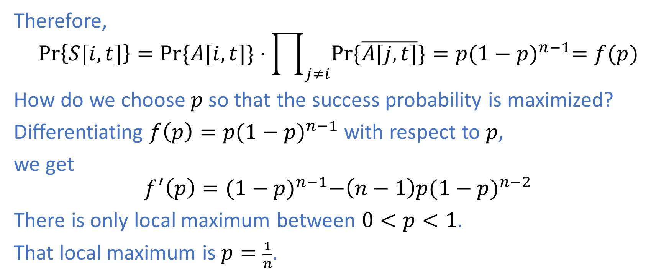
Contention Resolution: Analysis
Therefore,
$$\operatorname{Pr}\left\{S[i,t]\right\}=Pr⁡\{A[i,t]\}⋅\prod_{j≠i}{Pr⁡\{\overline{A[j,t]}\}}=p{(1−p)}^{n−1}=f(p)$$
How do we choose $p$ so that the success probability is maximized?
Differentiating $f\left(p\right)=p{(1−p)}^{n−1}$ with respect to $p$,
we get
$$f^{′}\left(p\right)={(1−p)}^{n−1}−\left(n−1\right)p{(1−p)}^{n−2}$$
There is only local maximum between $0<p<1$.
That local maximum is $p=\frac{1}{n}$.

Slide 28
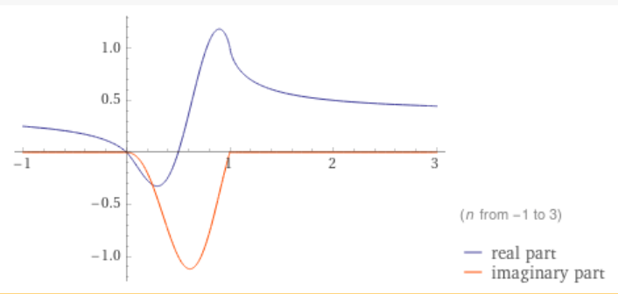

Contention Resolution: Analysis
$$\operatorname{Pr}\left\{S[i,t]\right\}=\frac{1}{n}{(1−\frac{1}{n})}^{n−1}$$
As $n$ increases from $2$, the function ${(1−\frac{1}{n})}^{n−1}$ monotonically converges from $\frac{1}{2}$ upto $\frac{1}{e}$.

Slide 29

Contention Resolution: Analysis
Hence, we can bound $\operatorname{Pr}\left\{S[i,t]\right\}$ as follows:
$\frac{1}{en}≤Pr\left\{S[i,t]\right\}≤\frac{1}{2n}$
Asymptotically,
$\operatorname{Pr}\left\{S[i,t]\right\}= Θ(\frac{1}{n})$

Slide 30
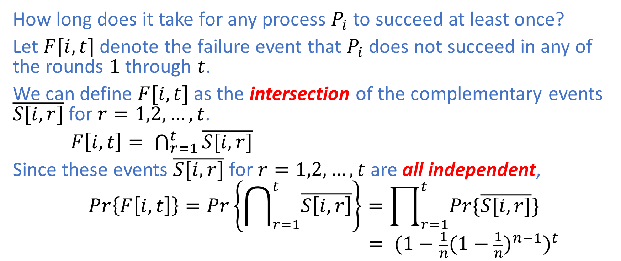
Contention Resolution: Analysis
How long does it take for any process $P_{i}$ to succeed at least once?
Let $F[i,t]$ denote the failure event that $P_{i}$ does not succeed in any of the rounds $1$ through $t$.
We can define $F[i,t]$ as the intersection of the complementary events $\overline{S[i,r]}$ for $r=1,2,…,t$.
$F\left[i,t\right]= \bigcap_{r=1}^{t}{\overline{S[i,r]}}$
Since these events $\overline{S[i,r]}$ for $r=1,2,…,t$ are all independent,
$$Pr\left\{F\left[i,t\right]\right\}=\operatorname{Pr}\left\{\bigcap_{r=1}^{t}{\overline{S\left[i,r\right]}}\right\}=\prod_{r=1}^{t}{Pr⁡\{\overline{S[i,r]}\}}$$
$$= {(1−\frac{1}{n}{(1−\frac{1}{n})}^{n−1})}^{t}$$

Slide 31
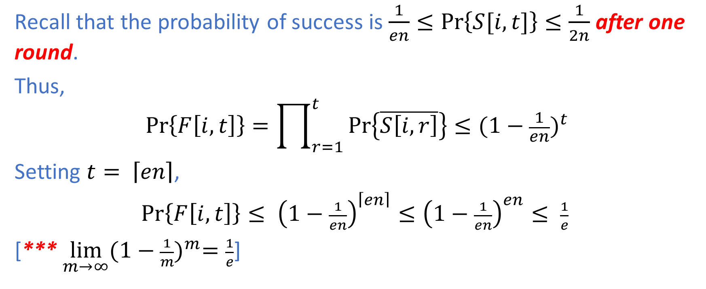
Contention Resolution: Analysis
Recall that the probability of success is $\frac{1}{en}≤Pr\left\{S[i,t]\right\}≤\frac{1}{2n}$after one round.
Thus,
$$Pr\left\{F\left[i,t\right]\right\}=\prod_{r=1}^{t}{\operatorname{Pr}\left\{\overline{S\left[i,r\right]}\right\}≤{(1−\frac{1}{en})}^{t}}$$
Setting $t= \left\lceil en\right\rceil$,
$Pr\left\{F\left[i,t\right]\right\}≤ {\left(1−\frac{1}{en}\right)}^{\left\lceil en\right\rceil }≤{\left(1−\frac{1}{en}\right)}^{en}≤ \frac{1}{e}$
[*** $\lim_{m→∞}{{(1−\frac{1}{m})}^{m}=\frac{1}{e}}$]

Slide 32
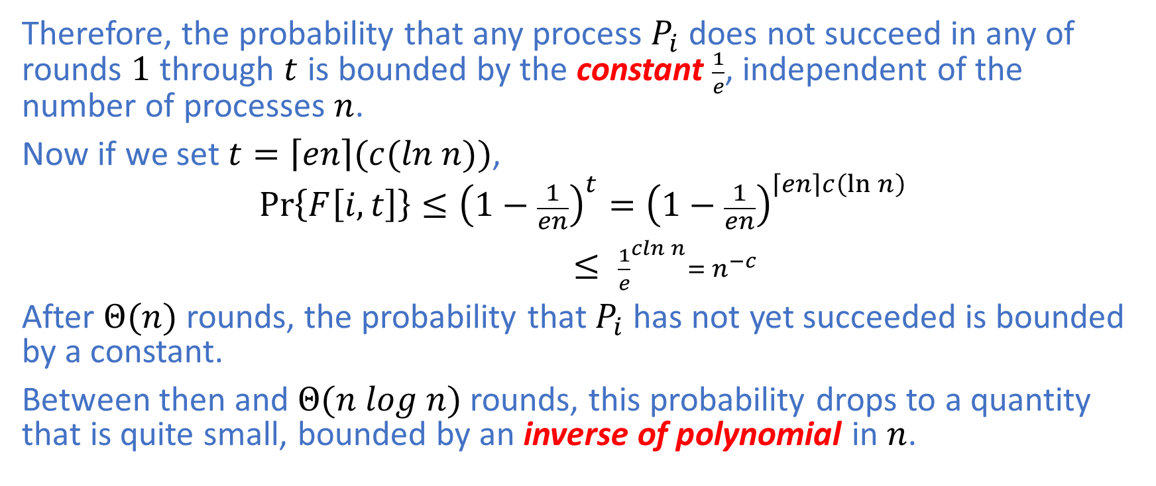
Contention Resolution: Analysis
Therefore, the probability that any process $P_{i}$ does not succeed in any of rounds $1$ through $t$ is bounded by the constant $\frac{1}{e}$, independent of the number of processes $n$.
Now if we set $t=\left\lceil en\right\rceil (c(ln n))$,
$$Pr\left\{F\left[i,t\right]\right\}≤{\left(1−\frac{1}{en}\right)}^{t}={\left(1−\frac{1}{en}\right)}^{\left\lceil en\right\rceil c\left(\ln{n}\right)}$$
$≤ {\frac{1}{e}}^{cln n}= n^{−c}$
After $Θ(n)$ rounds, the probability that $P_{i}$ has not yet succeeded is bounded by a constant.
Between then and $Θ(n log n)$ rounds, this probability drops to a quantity that is quite small, bounded by an inverse of polynomial in $n$.

Slide 33
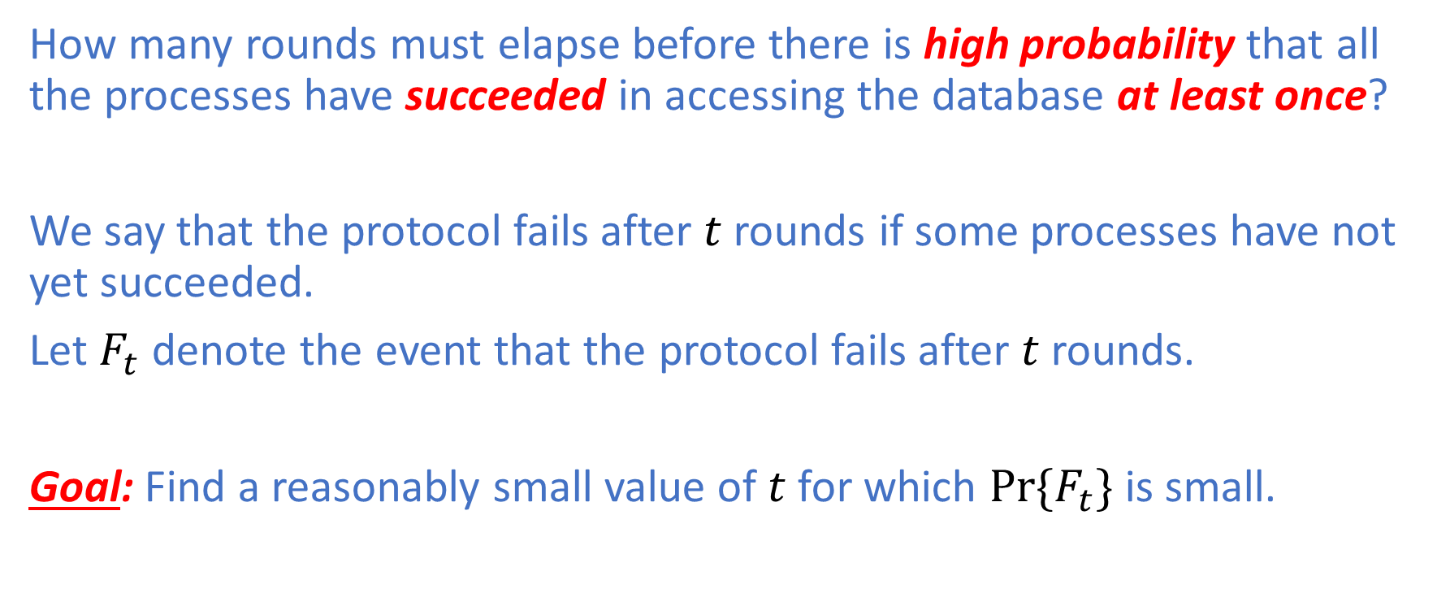
Contention Resolution: Analysis
How many rounds must elapse before there is high probability that all the processes have succeeded in accessing the database at least once?
We say that the protocol fails after $t$ rounds if some processes have not yet succeeded.
Let $F_{t}$ denote the event that the protocol fails after $t$ rounds.
Goal: Find a reasonably small value of $t$ for which ${Pr⁡\{F}_{t}\}$ is small.

Slide 34
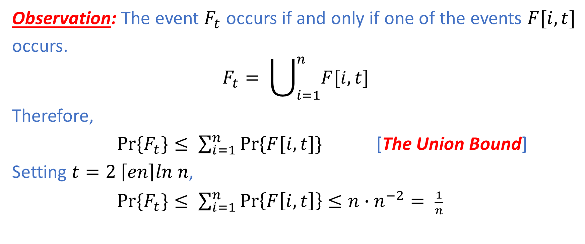
Contention Resolution: Analysis
Observation: The event $F_{t}$ occurs if and only if one of the events $F[i,t]$
occurs.
$$F_{t}= \bigcup_{i=1}^{n}{F[i,t]}$$
Therefore,
${Pr⁡\{F}_{t}\}≤ \sum_{i=1}^{n}{Pr⁡\{F[i,t]\}}$ [The Union Bound]
Setting $t=2 \left\lceil en\right\rceil ln n$,
${Pr⁡\{F}_{t}\}≤ \sum_{i=1}^{n}{\operatorname{Pr}\left\{F\left[i,t\right]\right\}}≤n∙n^{−2}= \frac{1}{n}$

Slide 35
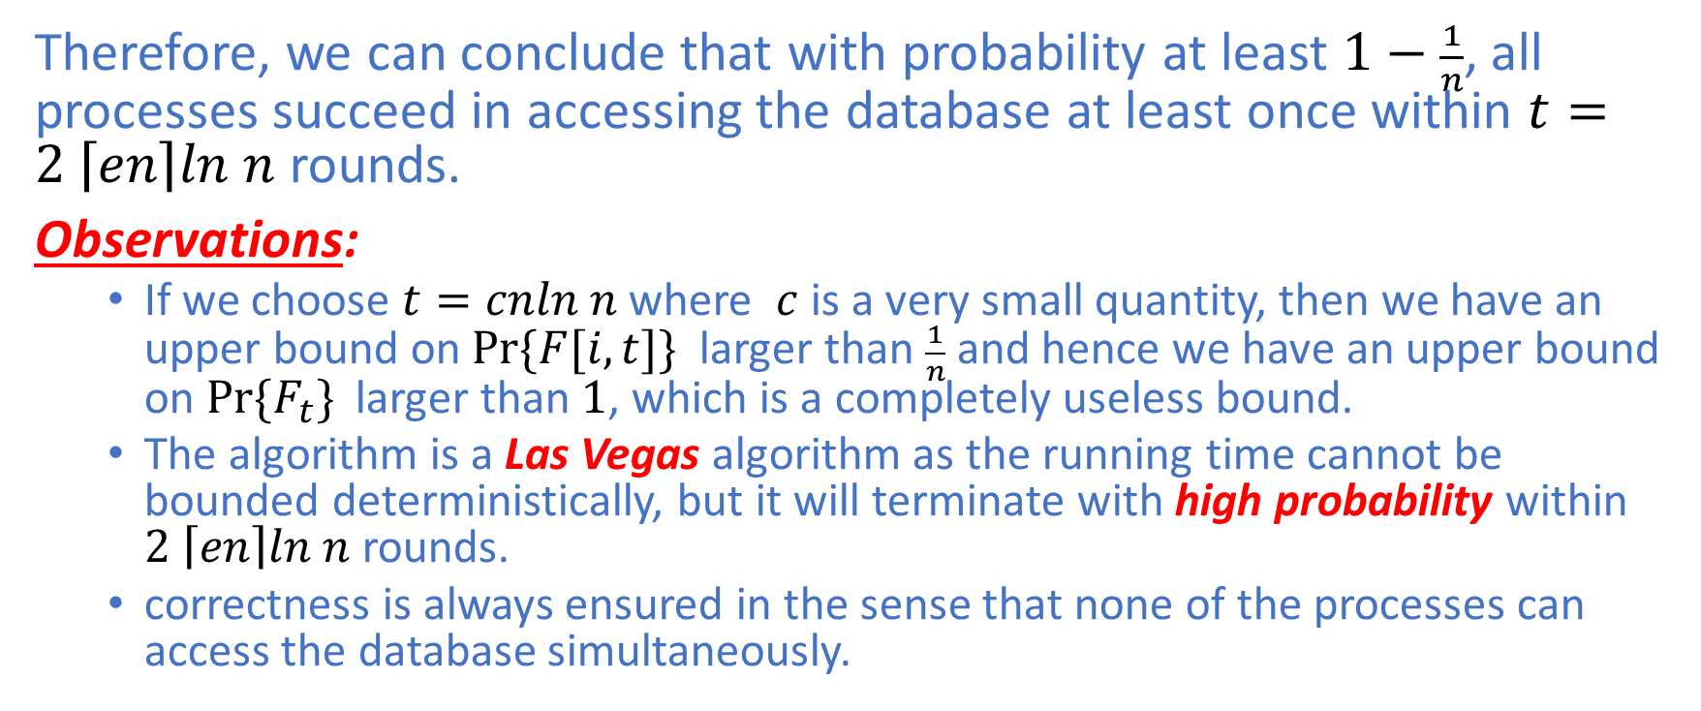
Contention Resolution: Analysis
Therefore, we can conclude that with probability at least $1−\frac{1}{n}$, all processes succeed in accessing the database at least once within $t=2 \left\lceil en\right\rceil ln n$ rounds.
Observations:
If we choose $t=cnln n$ where $c$ is a very small quantity, then we have an upper bound on$Pr\{F[i,t]\}$ larger than $\frac{1}{n}$ and hence we have an upper bound on ${Pr⁡\{F}_{t}\}$ larger than $1$, which is a completely useless bound.
The algorithm is a Las Vegas algorithm as the running time cannot be bounded deterministically, but it will terminate with high probability within $2 \left\lceil en\right\rceil ln n$ rounds.
correctness is always ensured in the sense that none of the processes can access the database simultaneously.

Slide 36
Summary
A randomized algorithm is a
Monte Carlo randomized algorithm if
It returns a result which is probably correct
it always return a result
its running time is always deterministically bounded
Las Vegas randomized algorithm if
it always returns the correct result
Its running is bounded in expectation

